Slide 1


WELCOME
1

Slide 2

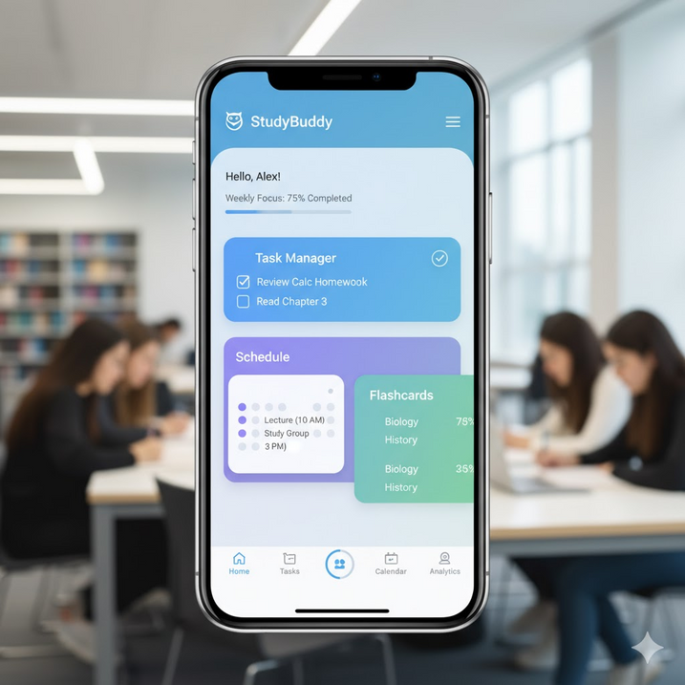

Project: StudyBuddy
A Mobile Learning Assistant App
Course Code: CSE 2201
Course Title: Software Engineering & System Analysis
Presented By
Abdullah Atif
ID: 241311051
Semester: 4th
2

Slide 3
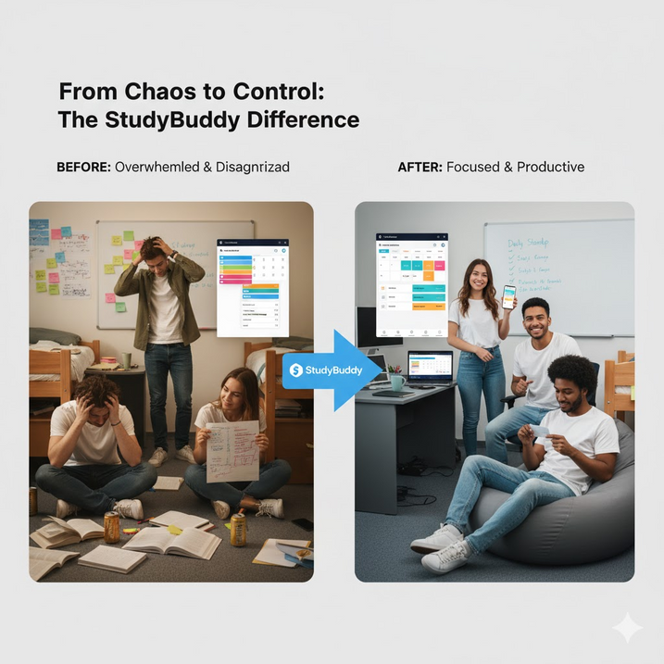
Why StudyBuddy
• University students struggle with productivity, time management & collaboration
• Need a unified platform for schedules, notes, and progress tracking
3

Slide 4
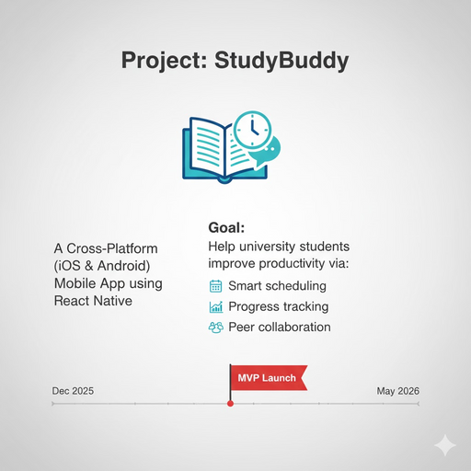

Goal
Help university students improve productivity via:
• Smart scheduling
• Progress tracking
• Peer collaboration
MVP Launch: May 30, 2026
4

Slide 5


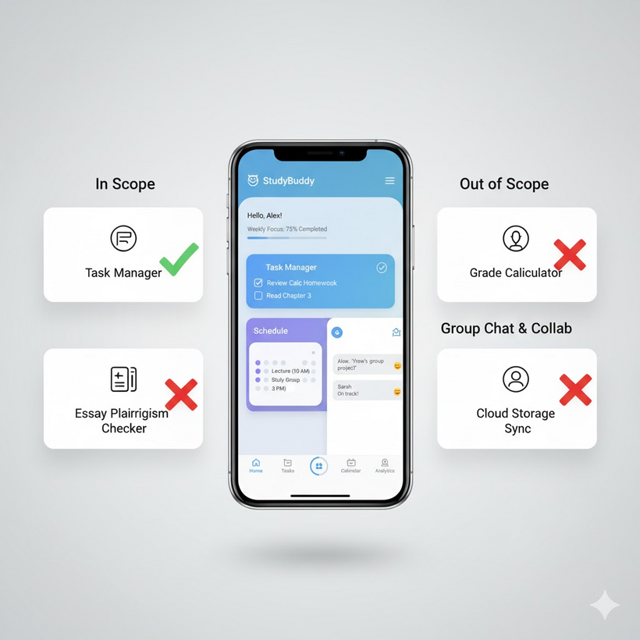

Key Features
In Scope (MVP)
✓ User Authentication (Email, Google, SSO)
✓ Personal Dashboard (Upcoming tasks)
✓ Smart Scheduler (Pomodoro AI)
✓ Study Groups + Real-time Chat
✓ Progress Analytics (Charts)
✓ Resource Library (PDFs, Flashcards)
✓ Push Notifications
Out of Scope
✗ Desktop App
✗ Offline Sync
✗ AI Tutoring (Phase II)
5

Slide 6




Budget Allocation
Total Budget: 480,000 BDT
Human Resources 240,000 (50%)
Cloud & Tools 120,000 (25%)
QA Devices 80,000 (17%)
Misc + Contingency 40,000 (8%)
Top Items:
• Dev Stipends: 180K
• Firebase: 75K
• Test Devices: 80K
6

Slide 7
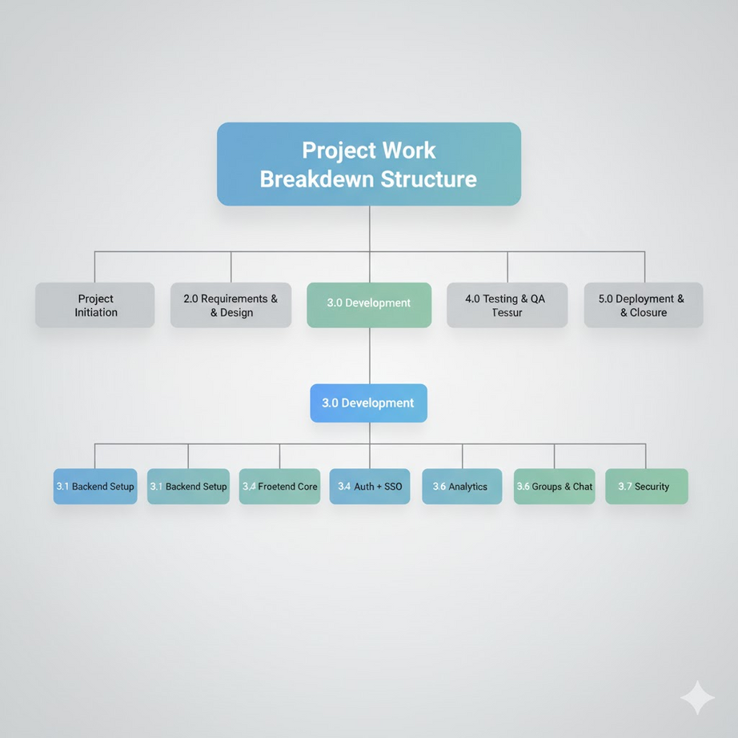
WORK BREAKDOWN STRUCTURE (WBS)
1.0 Project Initiation
2.0 Requirements & Design
3.0 Development
├ 3.1 Backend Setup
├ 3.2 Frontend Core
├ 3.3 Auth + SSO
├ 3.4 Scheduler
├ 3.5 Groups & Chat
├ 3.6 Analytics
└ 3.7 Security
4.0 Testing & QA
5.0 Deployment & Closure
7

Slide 8
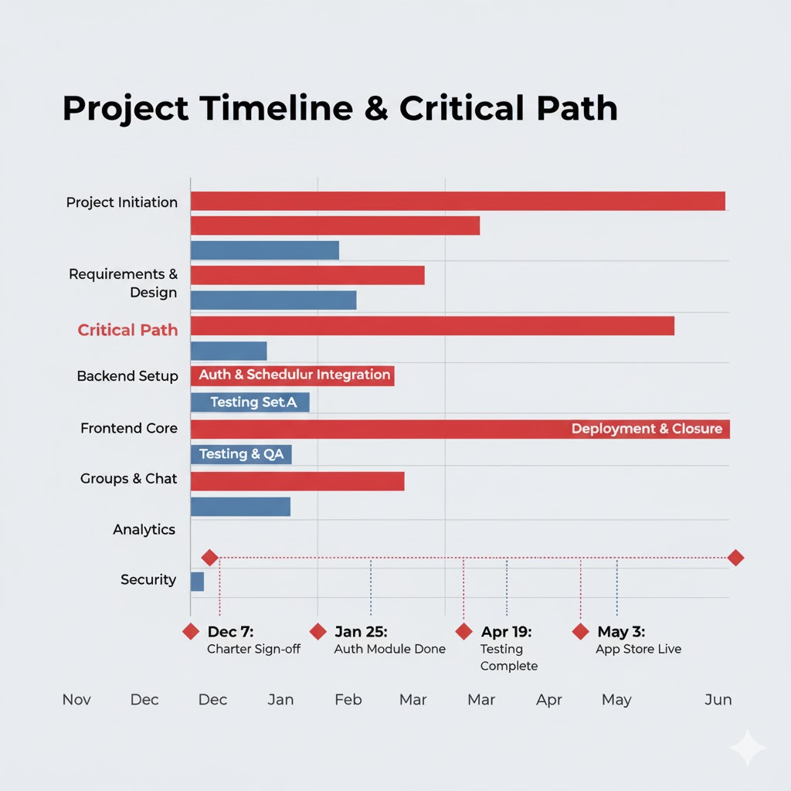
Project Schedule (Gantt Chart)
Critical Path:
Initiation → Design → Backend → Auth/Scheduler → Testing → Deployment
Key Milestones:
• Dec 7: Charter Sign-off
• Jan 25: Auth Module Done
• Apr 19: Testing Complete
• May 3: App Store Live
8

Slide 9
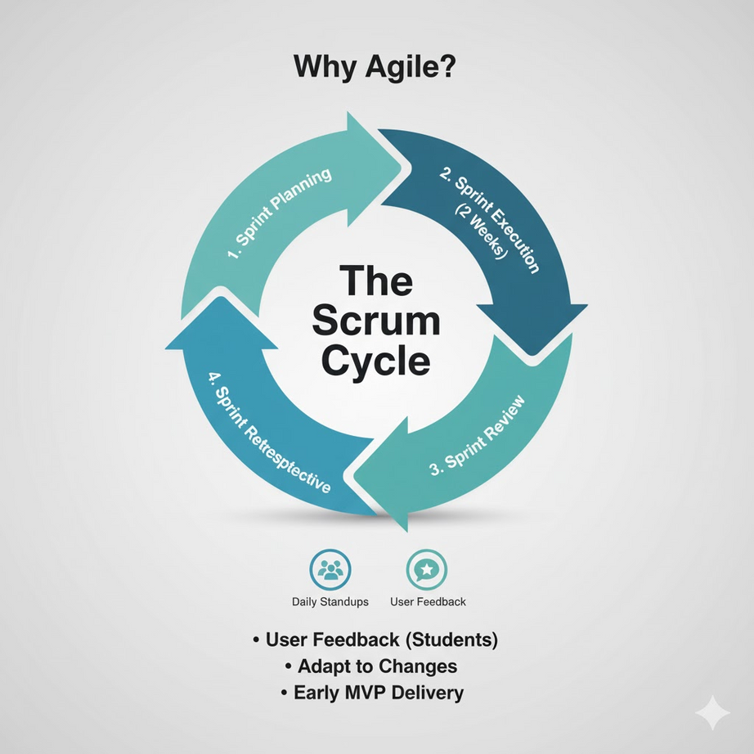
Agile Scrum Methodology
Why Agile?
• User feedback (students)
• Adapt to changes
• Early MVP delivery
6 x 2-Week Sprints:
1. Foundation (Login + Backend)
2. Scheduler + Notifications
3. Groups & Chat
4. Resources & Analytics
5. Polish & QA
6. Final Testing + Launch
Daily Standups | Sprint Reviews
9

Slide 10
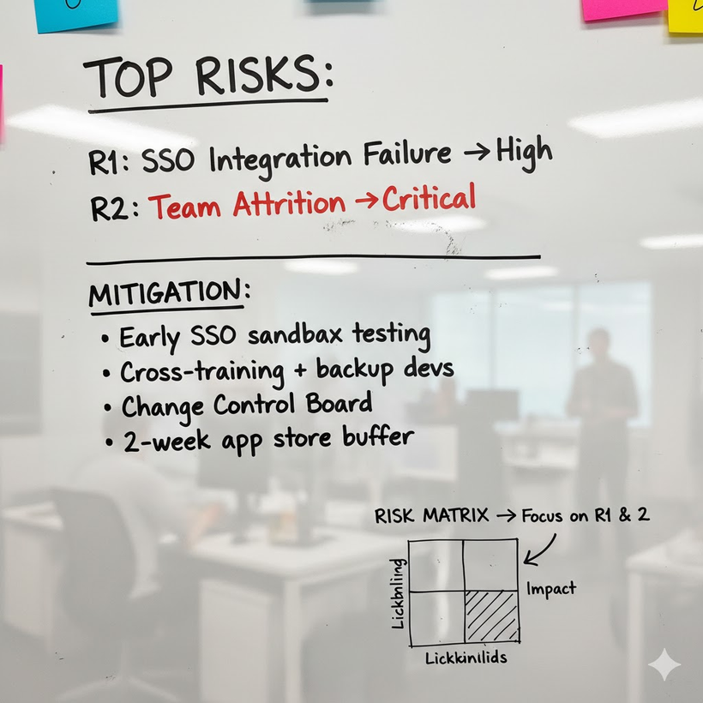
Risk Management
Top Risks:
R1: SSO Integration Failure → High
R2: Team Attrition → Critical
Mitigation:
• Early SSO sandbox testing
• Cross-training + backup devs
• Change Control Board
• 2-week app store buffer
Risk Matrix → Focus on R1 & R2
10

Slide 11



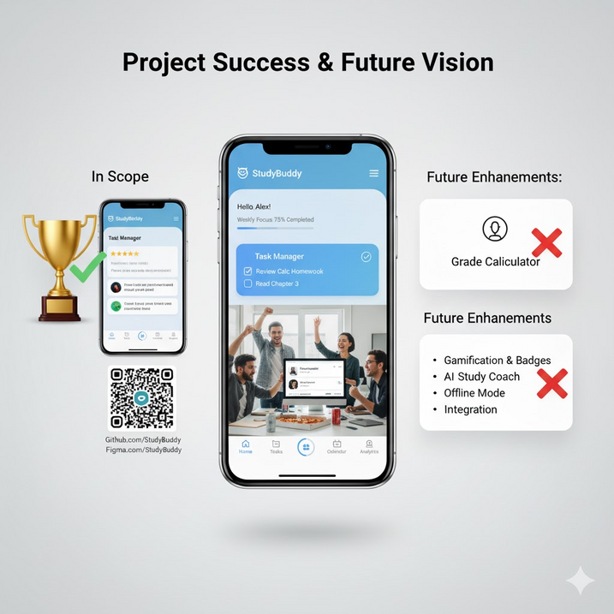
Conclusion & KPIs
StudyBuddy = Professional-Grade Project
Success Will Be Measured By:
• 500+ Active Users
• 4.0+ App Store Rating
• 90% Feature Completion
• On-Time & Within 480K BDT
11

Slide 12

Thank You
12

